Slide 1

SimpliSpeak
HCI course · Phase 1 · Low-fidelity (rough) prototype
AI-based text simplification for cognitive accessibility in blind user audio interfaces
[Team members] · [Course code] · [Date]
Notes:
Introduce the project in one sentence: SimpliSpeak is an audio-first reader that lets blind users decide how simple the text they hear should be. Today we show Phase 1, a low-fidelity but working prototype, plus the reasoning behind it. Replace the bracketed placeholders with team names, course code and date.

Slide 2
Audio makes hard writing harder
A screen reader speaks text exactly as written. If the writing is complex, hearing it does not make it easier to understand.
Linear
Fleeting
Dense
Listeners cannot skim ahead or glance back the way readers do.
Spoken words vanish, so long sentences must be held in memory.
Medical, legal and bank letters use hard words, which makes listening even harder.
SimpliSpeak · HCI Phase 1
2
Notes:
Set up the gap. Accessibility work for blind users usually fixes access: can the screen reader reach the text? Our focus is the next barrier, comprehension. Audio is linear, fleeting and unforgiving of dense wording. Add your own sources from the literature review here if your course requires citations.

Slide 3
What we want to find out
Our questions
What we built in Phase 1
Do listeners understand more when the wording is simpler?
Is it easy to use, and do people trust it?
Do blind users prefer pasting copied text or scanning paper?
A prototype with 11 screens
Simpler wording written by hand for 3 samples
Clipboard paste, scan and a text box
Voice, gesture and keyboard controls
SimpliSpeak · HCI Phase 1
3
Notes:
State the three research questions, then the scope. Be explicit that email and share-sheet integration is out of scope: it depends on the phone's operating system and would not fit the course timeline. The research questions return on the evaluation slide.

Slide 4
What research tells us
Listening takes effort
Plain language helps
Blind users listen differently
People can only hold so much in mind at once (Sweller, 1988). Spoken words vanish, so long, packed sentences are harder to follow.
Accessibility guidelines ask for easy-to-read text (WCAG 2.2, 3.1.5) and support people with learning and thinking difficulties (W3C COGA). Simplifying text by computer is a well-studied area (Siddharthan, 2014).
Screen-reader users jump around rather than listen in order (Borodin et al., 2010) and often use fast speech (Asakawa et al., 2003). Short sounds can carry meaning too (Blattner et al., 1989).
SimpliSpeak · HCI Phase 1
4
Notes:
Three themes from the literature: cognitive load, plain language and text simplification, and how blind users use audio interfaces. Full references are on the last content slide. Before submitting, check each reference against the original source and add DOIs or page numbers, and add any papers your own search finds. This is a starter review, not an exhaustive one.

Slide 5
What we learned, and what we did
What research says | What we did
People can only hold so much in mind | Short parts, with repeat and back at any time
Simpler wording is easier to follow | Four levels, from Original to Very simple
Simplifying can lose detail | Key facts never change, and the original is always available
Listeners jump around | Separate buttons for next, back, repeat and explain
Fast speech is common | Speed control up to 1.8x, and short sounds instead of extra words
What is new here: the listener chooses how simple the text is, while listening.
SimpliSpeak · HCI Phase 1
5
Notes:
Each design decision traces back to a theme from the previous slide. The gap statement is our positioning. Confirm it against your own literature search before presenting, and soften or sharpen the wording depending on what you find.

Slide 6
Two example users guide the design
Asha, 34, blind since birth
Ravi, 58, recently lost sight
Experienced screen-reader user
New to screen readers
Uses a screen reader on her phone every day. Bank letters and medicine leaflets still need a sighted helper because the wording is hard.
Learning audio tools while managing health paperwork. Long sentences and unfamiliar terms are overwhelming at normal speaking speed.
Wants: independence, and plain wording without being talked down to.
Wants: a slower pace, repetition, and simple ways to ask for help.
Example users based on reading and team discussion. We will check them with real interviews later.
SimpliSpeak · HCI Phase 1
6
Notes:
These are proto-personas: hypotheses, not research findings. They bracket the range from fluent to new screen-reader users. Be upfront that interviews with real blind and low-vision users are planned for validation. Replace the names and details if your team has real interview data.

Slide 7
User story: Ravi and the pharmacy leaflet
Situation
Ravi lost his sight a year ago. A new medicine comes with a leaflet he cannot read, and a screen reader makes its dense wording hard to follow.
Goal
Know how many tablets to take and when to call a doctor, without asking his daughter every time.
With SimpliSpeak
He copies the text, taps Paste from clipboard, and hears it in simple words. When a sentence is still hard he says “simpler”, and he asks what “hepatic” means.
Outcome
He answers “Yes, clear” and takes his medicine safely, on his own.
SimpliSpeak · HCI Phase 1
7
Notes:
This is a fictional scenario built from the proto-persona on the earlier slide. Tell it as a story. The next slide shows it as a storyboard. If you have interview data, replace the scenario with a real one.

Slide 8
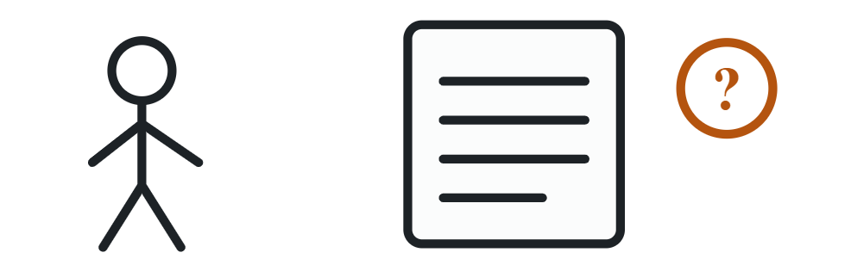


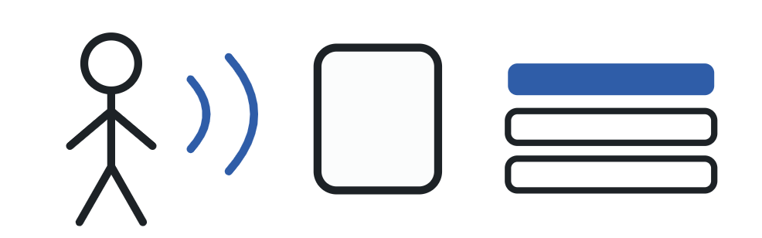
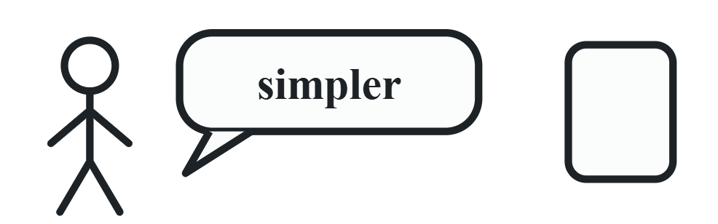

Storyboard: six moments
1. Ravi gets a leaflet he cannot read.
2. He copies the text on his phone.
3. He taps Paste from clipboard. It says “Pasted 120 words.”
4. He listens one short part at a time.
5. A part is hard, so he says “simpler”.
6. He answers “Yes, clear” and takes his medicine on his own.
SimpliSpeak · HCI Phase 1
8
Notes:
Walk through the six panels in order. Panel 3 is the new one-tap clipboard step. Panel 5 shows the live level control. Each panel matches a screen in the Figma prototype, so you can point to it.

Slide 9
Five needs shape the features
What users need | What we built
Understand without re-reading | Short parts, with one-tap repeat
Stay in control of the AI | Four levels chosen by the listener
Trust what was simplified | The original text is one command away
Learn hard words | Explanations on request, never unprompted
Use it without looking | Voice, gestures, keyboard and short sound cues
SimpliSpeak · HCI Phase 1
9
Notes:
Each need comes from the personas and drives one feature. This is the bridge from user research to design. Point out that the second and third needs, control and trust, are specifically about AI: people must not feel the system is deciding for them or hiding things.

Slide 10
The listener, not the AI, decides how simple the text should be.
Our proposal
SimpliSpeak is an audio-first reader that simplifies text sentence by sentence, on the listener's command, without losing their place.
SimpliSpeak · HCI Phase 1
10
Notes:
This is the one sentence to remember. Most AI simplifiers produce one fixed output. We put the level under the listener's control and keep it adjustable mid-listening, which matters because audio cannot be re-scanned the way a page can.

Slide 11
Four features make up SimpliSpeak
Short parts
Choose the level
Text is read in short parts. Listeners can go back, repeat or move on with one tap.
Original, Light, Simple or Very simple. Changing level keeps the listener on the same sentence.
Word help
Original always available
Hard words are explained only when asked, by voice, gesture or button.
The exact source text is always one command away, so simplification never hides anything.
SimpliSpeak · HCI Phase 1
11
Notes:
Walk through the four features and tie each back to a need on slide 4. Emphasise that simplification is always reversible, which is the main trust mechanism.

Slide 12
How text gets into the app
Method | What the user does
Paste from clipboard | Copies text anywhere, taps one button
Scan | Points the camera at paper, hears guidance
Text box | Types or pastes into a field
Share sheet, email, files | Sends text to the app from other apps
Clipboard and scan cover the two real situations: “I copied something” and “I have paper in front of me”. Connecting to email is too complex for our timeline.
SimpliSpeak · HCI Phase 1
13
Notes:
This slide records a design decision. Pasting into a text box is slow for a blind user, so the main route is one clipboard button that confirms by voice: "Pasted 120 words. Starting at Simple level." We deliberately defer share-sheet and email integration. The evaluation will compare clipboard against scan.

Slide 13
The core task: hard text to clear audio
Bring text in
Choose a level
Listen
Adjust
Give feedback
One short part at a time.
Simpler, more detail, explain, repeat.
Paste from clipboard, scan or open a sample.
→
Hear a preview first.
→
→
→
“No” starts again, one level simpler.
Loop: Listen and Adjust repeat until the text is clear. Nothing in the flow requires sight.
SimpliSpeak · HCI Phase 1
14
Notes:
This is the primary task flow tested in the prototype. Highlight the loop between Listen and Adjust: the key design decision is that adjusting never moves the listener away from their current sentence. In the live prototype, the screen-flow panel on the right lets you jump to any step.

Slide 14
Four ways to act on the Listen screen
Action | Button | Gesture | Voice | Keyboard
Play or pause | Play / Pause | Double tap | “pause”, “play” | Space
Next or back | Next / Back | Swipe right / left | “next”, “back” | Right / left arrow
Simpler or more detail | Simpler / More detail | Swipe up / down | “simpler”, “more detail” | Up / down arrow
Explain a word | Explain | Long press | “explain” | E
Repeat | Repeat | Not assigned | “repeat” | R
SimpliSpeak · HCI Phase 1
16
Notes:
Redundant input channels are an accessibility feature: a user can pick whichever suits their ability, setting or assistive technology. Short non-speech tones (earcons) confirm next, back, level up, level down, bookmark and error, so confirmation does not add more words to listen to. Gestures may conflict with the phone's own screen-reader gestures; that is a risk we test in the next phase.

Slide 15
One warning, four levels
Level | What the listener hears (medicine leaflet, part 4)
Original | Discontinue use and seek immediate medical attention if you experience difficulty breathing, swelling of the face, or severe skin reactions.
Light | Stop taking it and get medical help right away if you have trouble breathing, a swollen face, or bad skin reactions.
Simple | Stop the medicine right away if you cannot breathe well. Stop if your face swells. Stop if your skin is very sore. Call a doctor now.
Very simple | Stop the medicine. Call a doctor now if you cannot breathe. Call now if your face swells. Call now if your skin hurts badly.
The safety facts survive every level: stop the medicine, breathing, face, skin, doctor.
SimpliSpeak · HCI Phase 1
17
Notes:
This is real content from the prototype's medicine-leaflet sample. Read the original aloud, then the very simple version, to let the audience hear the difference. Make the point that a simpler level changes the form, not the facts. That is also exactly what we will test in the comprehension study.

Slide 16
Simplifying must never hide or change facts
Protected facts
Original on demand
Honest limits
Doses, dates, amounts, names and warnings stay exact at every level.
Saying “original” plays the exact source text at any moment.
Planned for the real app: it says when it is unsure and offers the original instead.
For health and money, a wrong simplification is worse than none. Trust is a design requirement, not a feature.
SimpliSpeak · HCI Phase 1
18
Notes:
The first two cards are visible in the prototype. The third is a proposal for the implementation phase, where a real language model will make the simplification. Language models can drop or alter details, so we plan checks on numbers, dates and negations, plus an honest fallback to the original.

Slide 17
Prototype tour:
https://www.figma.com/design/U6Hc0EEJhZeWv5MggR3LUN/SimpliSpeak-%E2%80%93-Low-fi-prototype--HCI-Phase-1-?node-id=3-422&t=IuuX7aSQ3BEwPznT-0
SimpliSpeak · HCI Phase 1
19
Notes:
Use this as the demo script. The web prototype shows real speech and live level changes. The Figma file shows the screens and flow, but is silent. In the web prototype, the clipboard button reads the real clipboard when the browser allows it, and otherwise falls back to an example text so the demo never stalls.

Slide 18
How we will test it
Question | How | What we measure
Can people finish tasks without looking? | Users say their thoughts aloud, audio only | Success, time, errors
Do they understand more? | Questions about the text at each level | Share answered correctly
Is the effort lower? | Effort questionnaire (NASA-TLX) after each text | Effort score
Is it usable and trusted? | Usability questionnaire (SUS) and a short interview | Score and comments on trust
Which levels do people pick? | Log of taps in the prototype | Level changes per document
Clipboard or scan? | Same task with both input routes | Preference, time, errors
Participants: blind and low-vision screen-reader users, [number to be decided]. Three test tasks are built into the prototype.
SimpliSpeak · HCI Phase 1
21
Notes:
All five methods are standard HCI instruments. SUS is the System Usability Scale and NASA-TLX is a workload questionnaire. The prototype's audio-only switch hides all on-screen text so evaluators can test true eyes-free use, and its interaction log gives timestamps for each session. Decide participant numbers with your instructor.

Slide 19
References
Asakawa, C., Takagi, H., Ino, S., & Ifukube, T. (2003). Maximum listening speeds for the blind. Proceedings of ICAD 2003.
Blattner, M. M., Sumikawa, D. A., & Greenberg, R. M. (1989). Earcons and icons: Their structure and common design principles. Human-Computer Interaction, 4(1), 11–44.
Borodin, Y., Bigham, J. P., Dausch, G., & Ramakrishnan, I. V. (2010). More than meets the eye: A survey of screen-reader browsing strategies. Proceedings of W4A 2010.
Brooke, J. (1996). SUS: A quick and dirty usability scale. In Usability Evaluation in Industry. Taylor & Francis.
Hart, S. G., & Staveland, L. E. (1988). Development of NASA-TLX. In Human Mental Workload. North-Holland.
Kelley, J. F. (1984). An iterative design methodology for user-friendly natural language office information applications. ACM Transactions on Office Information Systems, 2(1), 26–41.
Nielsen, J. (1994). Enhancing the explanatory power of usability heuristics. Proceedings of CHI '94.
Siddharthan, A. (2014). A survey of research on text simplification. ITL, International Journal of Applied Linguistics, 165(2), 259–298.
Sweller, J. (1988). Cognitive load during problem solving: Effects on learning. Cognitive Science, 12(2), 257–285.
W3C. (2023). Web Content Accessibility Guidelines (WCAG) 2.2, success criterion 3.1.5, Reading Level.
W3C Cognitive and Learning Disabilities Accessibility Task Force. (2021). Making content usable for people with cognitive and learning disabilities.
SimpliSpeak · HCI Phase 1
24
Notes:
These are standard references for the topics cited, written from memory. Check every entry against the original source and add DOIs, page numbers and your required citation style before submitting. Add papers from your own literature search.

Slide 20
Next: test it with real listeners
Phase 1 shows the idea works as an interaction. Phase 2 makes the simplification real, and Phase 3 checks that it helps.
Questions and feedback welcome.
[Team members] · [Course code]
Notes:
Close by restating the proposal: the listener decides how simple the text is, and can always return to the original. Invite questions, then offer a live demo of the prototype.

